Slide 1
Movie Dataset Analysis and Recommendation System Using PySpark
MIA MD RAKIB 20233120001

Slide 2
Problem Statement & Objectives
Analyze large-scale movie data
Handle millions of records using PySpark
Predict movie performance
Build a recommendation system

Slide 3
Dataset Overview
MovieLens Full Dataset
45,000+ movies
26 million ratings
Metadata files

Slide 4
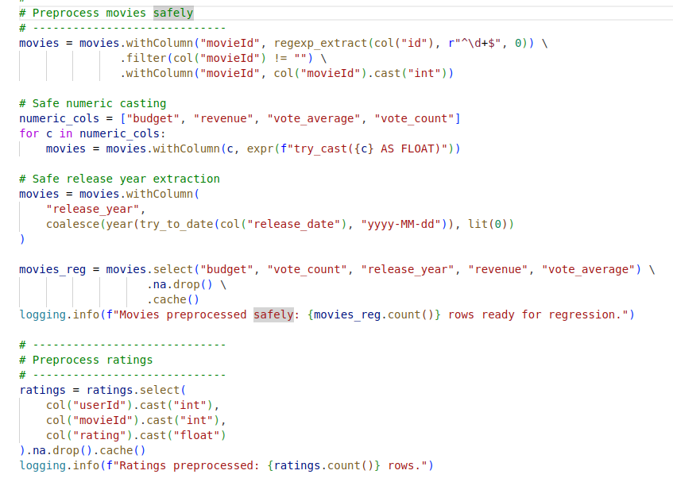
Data Preprocessing

Slide 5
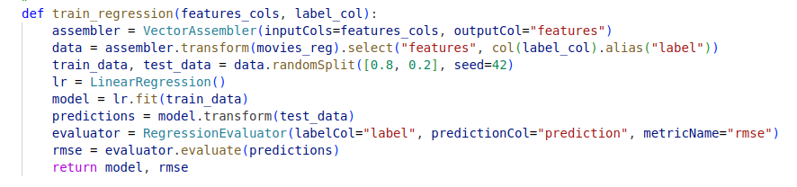
Regression Models
Revenue RMSE ≈ 30M
Vote Average RMSE ≈ 1.92
Vote prediction more stable
Notes:
hello

Slide 6
Recommendation System
Collaborative filtering
ALS algorithm
User–movie interaction matrix

Slide 7
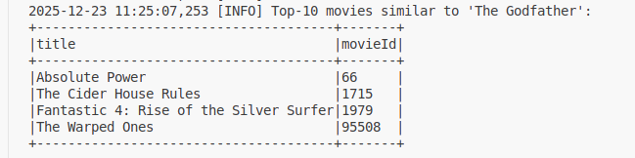
Similar Movie Recommendation
Input: Movie title
Output: Top similar movies
Based on latent features

Slide 8
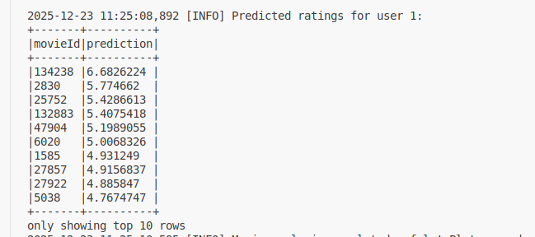
User Rating Prediction
Predicts unseen ratings
Personalized results
Top recommendations per user

Slide 9
Performance & Scalability
Memory-safe sampling
Spark MLlib
Successfully handled 26M ratings

Slide 10
Conclusion
Large-scale data successfully analyzed
Predictive models implemented
Recommendation system validated

Slide 11
Thank You

